Slide 1

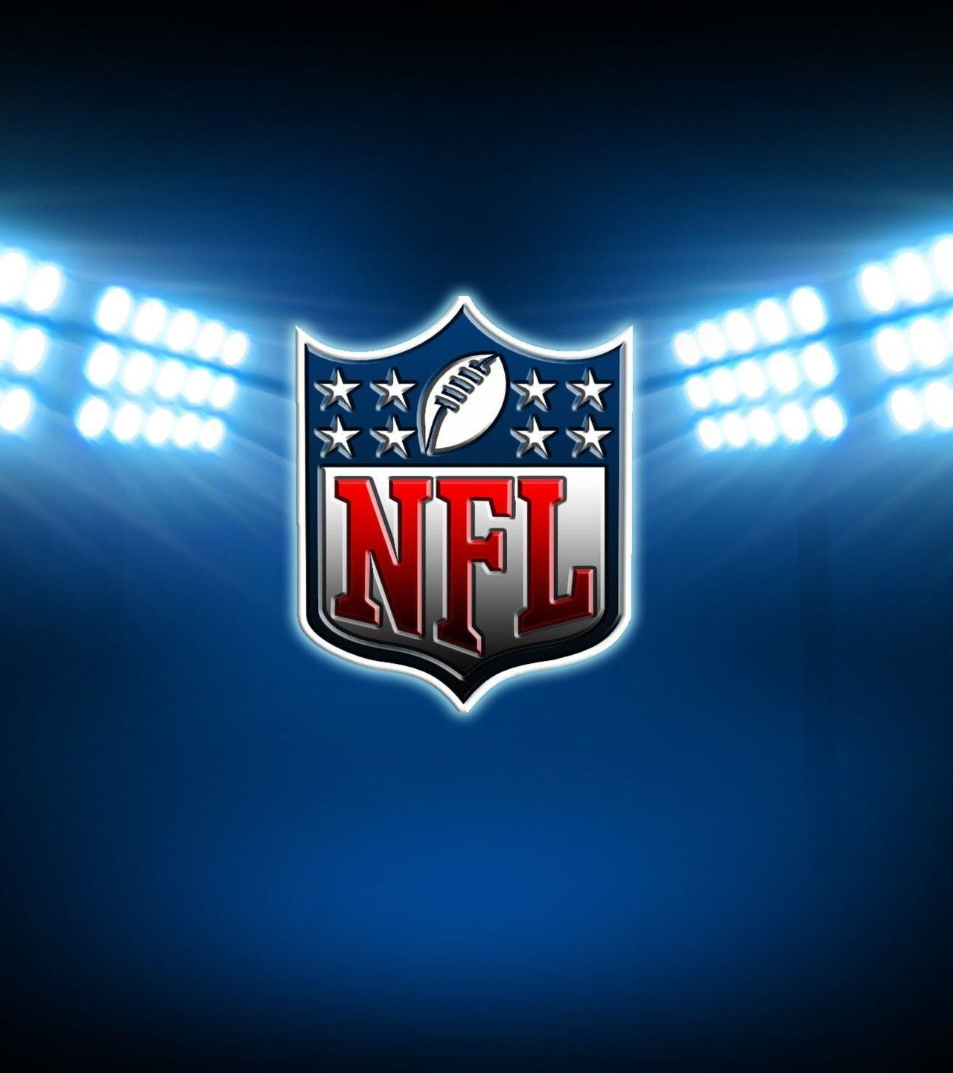
NFL Fandom
Which city should have the next NFL expansion team?
Robbie Geoghegan - Sebastian Osorio - Shivank Sood Vikrant Vaidya - Matthew Zlotnik

Slide 2
Problem Statement: Where the NFL should expand to next
The NFL made revenues of $22B over the 2018 season and is nearing revenues of $25B in 2019
Revenues are based on a business model with two parts: national revenue and local revenue
The NFL has been investigating new markets to expand into, location is extremely important - an expansion team’s success is therefore heavily dependent on local fans
Our project seeks to analyse how successful an expansion team would be in a new location and make a recommendation of where to expand for the NFL
NFL Business Model
National Revenue
Local Revenue
TV deals
Merchandising
Licensing
2018 Total: $8 B
(shared evenly by teams)
Ticket sales
Concessions
Corporate sponsors
2018 Total: $14 B
(team-based*)
*Cowboys earnt the most local revenue in 2018 at $950M while Oakland Raiders made the least at $357M
Source: tps://www.investopedia.com/articles/personal-finance/062515/how-nfl-makes-money.asp#:~:targetText=According%20to%20the%20Green%20Bay,national%20revenue%20from%20the%20league.
Source: https://www.statista.com/statistics/193553/revenue-of-national-football-league-teams-in-2010/

Slide 3
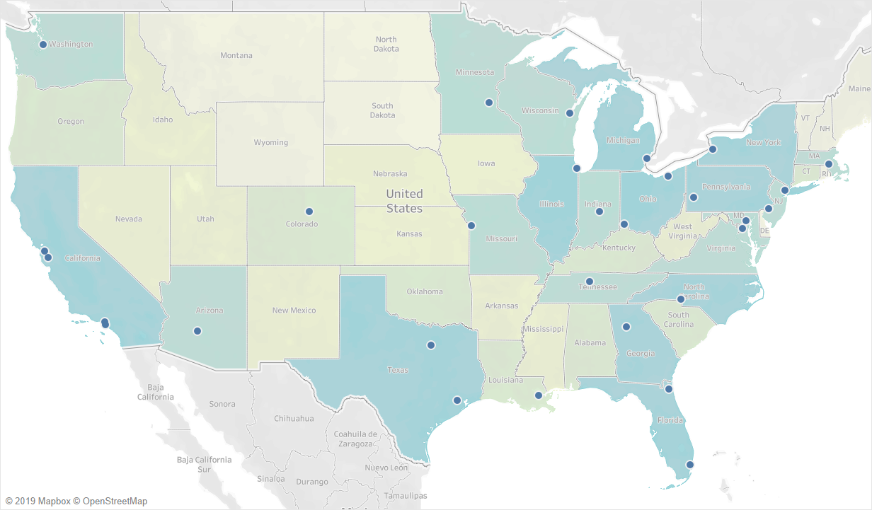
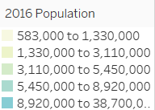
Current NFL team locations
There’s 32 teams right now in the NFL
They are usually in the most populated areas
Cities with 2 teams:
New York
Los Angeles
Notes:
Most teams on more populated areas (darker areas)
Checking for possible target cities within US and international markets like Canada, MX and England (where official NFL games have been played) and other markets like European countries.

Slide 4
We chose to use Twitter as a source of information
Source | Pros | Cons
Tweepy and Twitter’s API | Primary source Newest information | Limited to ~3,000 tweets at a time Can’t filter by keywords and location when downloading
Get Old Tweets package in Python | Can download large amounts of tweets at once Can filter by keywords (i.e. #NFL) and location | Possibly incomplete and dated Location information based on user bio - not ideal accuracy
Download repositories of tweets | Cleaned and consolidated already | Unclear how it data downloaded and how complete the information is
Our data source
Notes:
We ideally wanted to get the data directly from Twitter but could not filter by the locations of interest and NFL
Used Get Old Tweets as a fall back because it allows for filtering by keyword and location (so we could get data for each city in our list)
Its not ideal because it relies on the bio of a Twitter user which is freetext -- but we found it provided sufficient data for our needs
Data from the last 2 years
Near top 100 cities and extra cities (500 tweets each)
With the use of the #NFL hashtag
(maybe not needed to say) Looked at tweet repositories online but it was unclear how these were gathered

Slide 5
Data and pre-processing
Twitter
Data
100 most populous cities
Target overseas markets
Upto 500 tweets per location
#NFL
Secondary
Data
Population by city
NFL teams info and location
Twitter
Pre-
processing
Lemmatize
Remove stopwords
Tokenize
Lowerize
Secondary Data
Pre-
processing
General data cleaning
Use of insights in target city selection

Slide 6
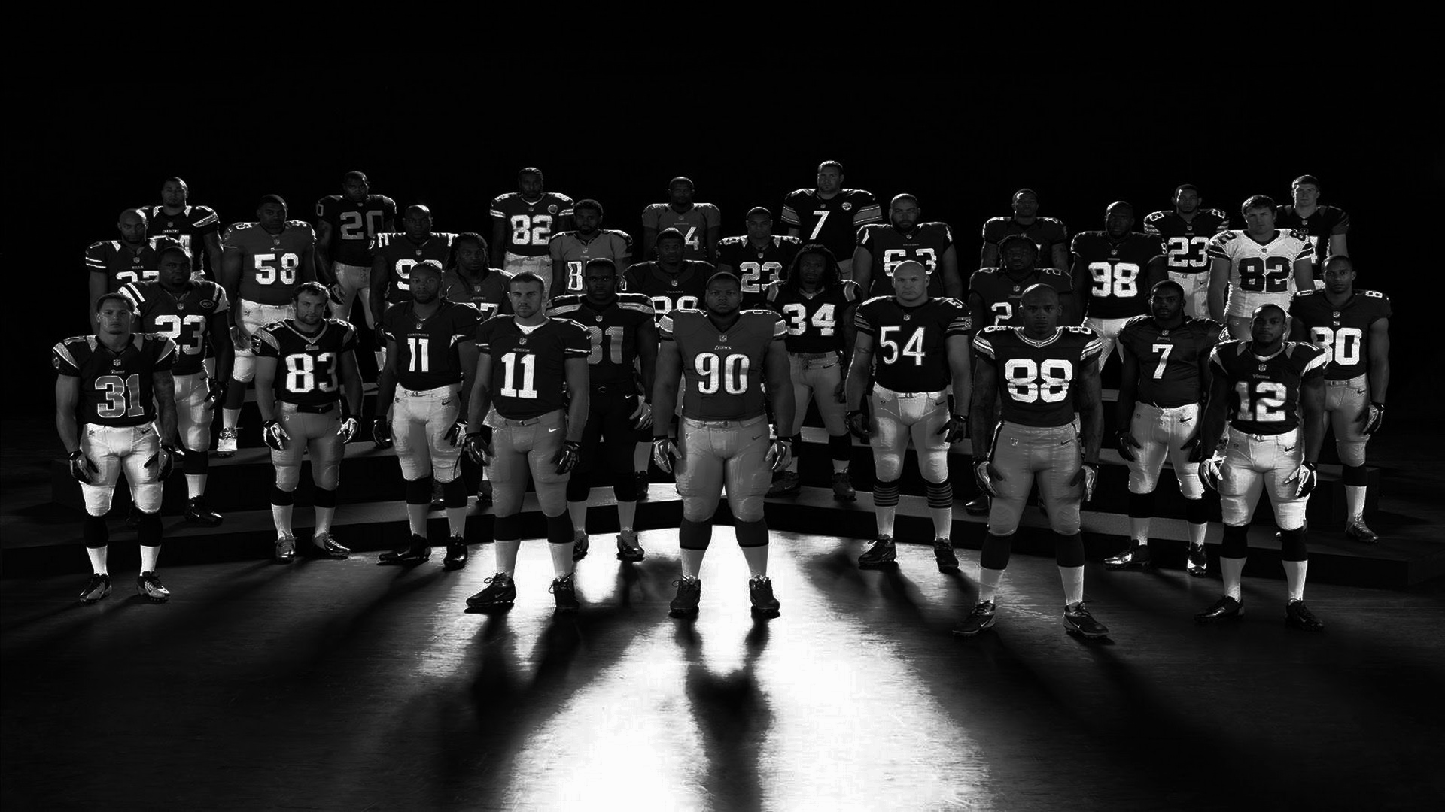
Sentiment Analysis
Keywords Analysis
Conclusion

Slide 7
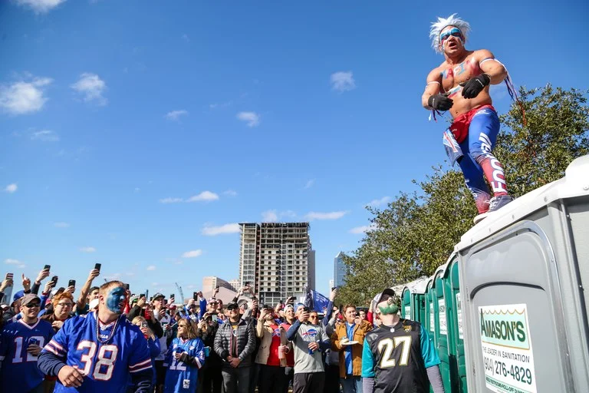
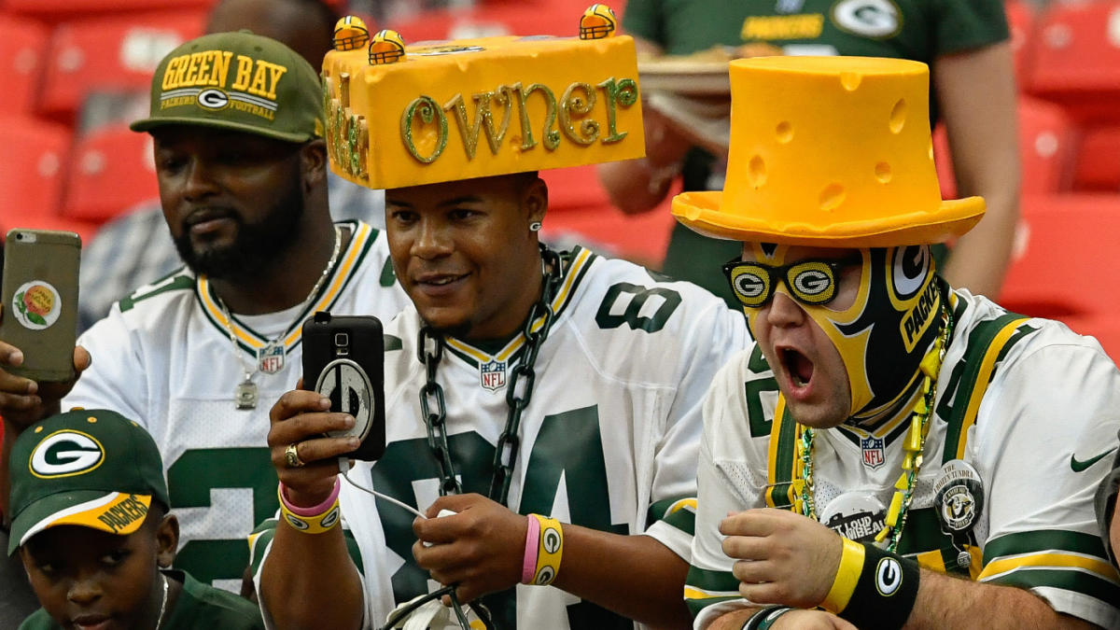
Strong Sentiments Likely Breed Passionate Fanbases
Vader Sentiment Analyzer
Passion Score

Slide 8
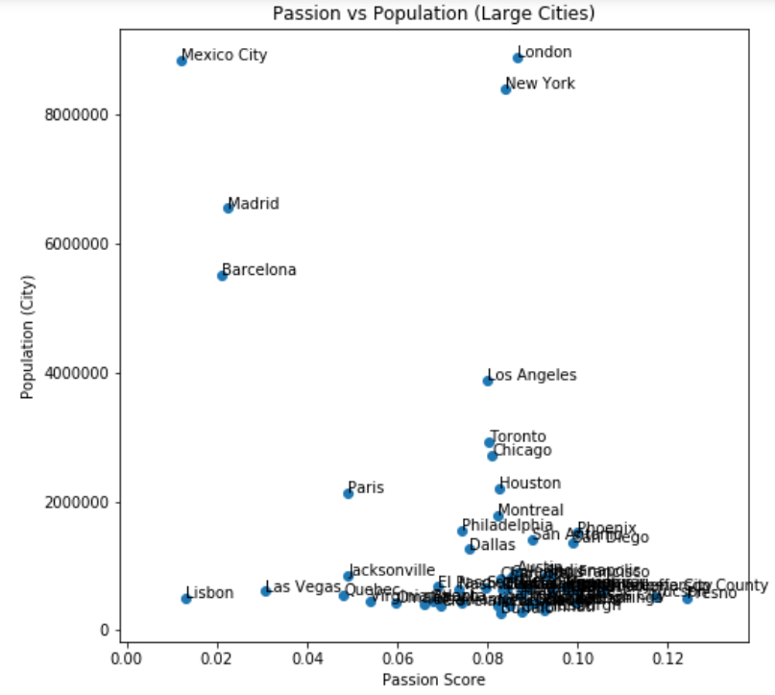
Passion and Population
Other Languages
Big Markets, Passionate Fans
Small Markets, Low Passion
Small Markets, Passionate Fans
Notes:
Call out Vegas

Slide 9
Sentiment Analysis
Keywords Analysis
Conclusion

Slide 10
Similar Tweets Across Cities - A Good Indicator ?
BET CRAZY
'Betting' 'sportsbetting' 'bettingtips' 'mybookie' 'bet' 'fantasyfootball' 'sportspicks' 'expertpicks' 'guaranteedpick' 'fantasy' 'gamblingtwitter'
WATCHMAN
'Youtube' 'podcast' 'watching' 'live' 'fireball' 'bigscreentv' ‘nflsunday’ ‘weekend’
HIGH SPIRITED
'Tequila' 'whiskey' 'beer' 'sportsbar' 'partytime'
Created corpus of frequently occurring words , splitting them into 3 distinct topics for similarity analysis
Spacy similarity analysis of tweets with these words - grouped by a city

Slide 11
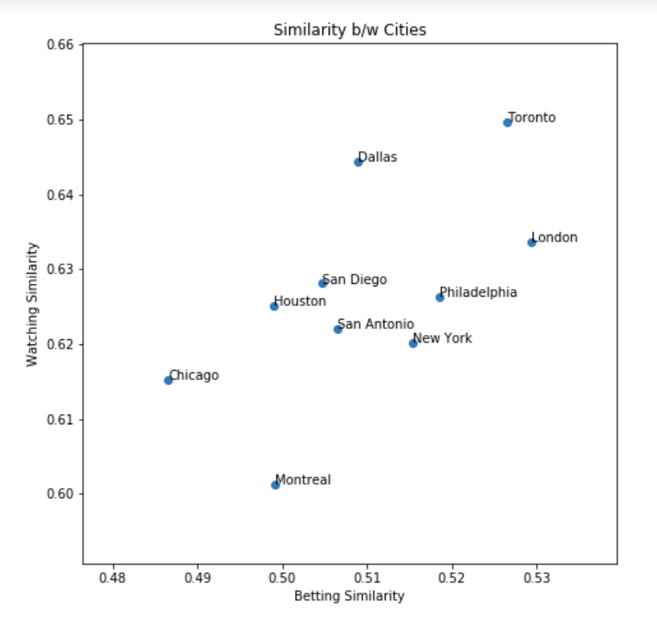
Which Are The Similar Cities . . . ?

Slide 12
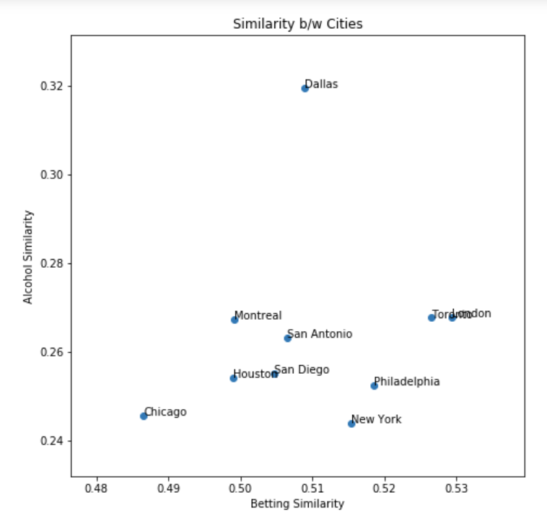
Which Are The Similar Cities . . . ?

Slide 13
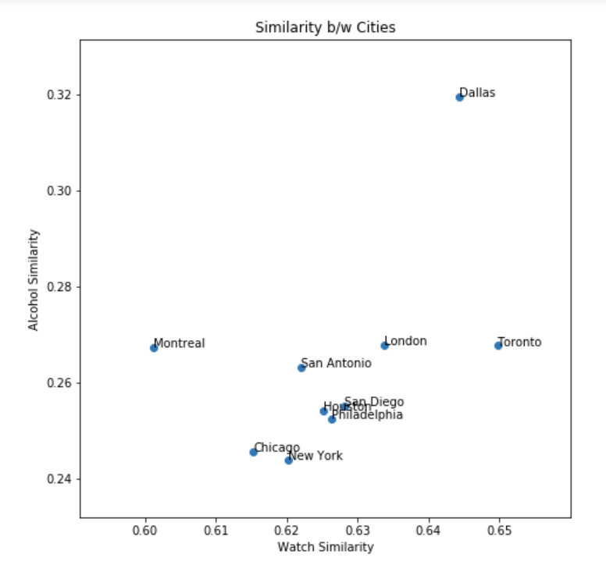
Which Are The Similar Cities . . . ?

Slide 14
Sentiment Analysis
Keywords Analysis
Conclusion

Slide 15
Insights & Recommendations
London is the most attractive market based on passion and market size - the NFL should target this location for its next team location
Jacksonville is the least attractive market of any location with a team and could be a candidate for moving to London (interestingly Jacksonville has played in London each year from 2013 and treats these games as ‘home’ matches)
Toronto is the second most attractive market based on passion and market size - the NFL should begin to hold games in Toronto to prepare it for further possible expansions
Conversations in these locations about “watchman” and “high spirits” map to key revenue streams of TV deals, sponsorships and concessions
Betting is legal and a popular topic in these markets - this presents opportunities for increased viewership and new revenue streams¹
https://www.casino.org/news/sports-betting-will-attract-millennials-increase-fan-engagement/#:~:targetText=A%20new%20study%20concludes%20that,hurt%20illegal%20underground%20gambling%20rings.
Notes:
London is the most attractive market based on passion and market size - the NFL should target this location for its next expansion team
Jacksonville is the least attractive market of any location with a team and could be a candidate for moving to London (interestingly Jacksonville has played in London each year from 2013 and treats these games as ‘home’ matches)
Toronto is the second most attractive market based on passion and market size - the NFL should begin to hold games in Toronto to prepare it for further possible expansions
Conversations in these locations about “watchman” and “high spirits” map to key revenue streams of TV deals, sponsorships and concessions
Betting is legal and a popular topic in these markets - this presents opportunities for increased viewership and new revenue streams¹

Slide 16
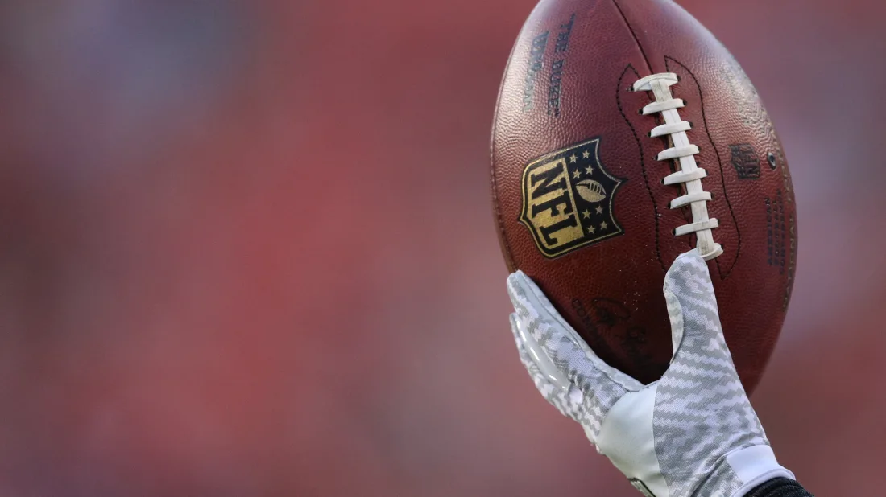
Questions?

